Slide 1
EMPLOYEE ATTRITION analysis
Vrindha Unni

Slide 2

ATTRITION
A reduction in the workforce due to employees leaving the organization voluntarily (resignations, retirements) or involuntarily (layoffs, terminations).
Employee attrition can impact organizational stability, productivity, and continuity of operations.
Attrition rates are typically measured and monitored to understand the reasons behind the losses and to implement strategies to mitigate them.

Slide 3
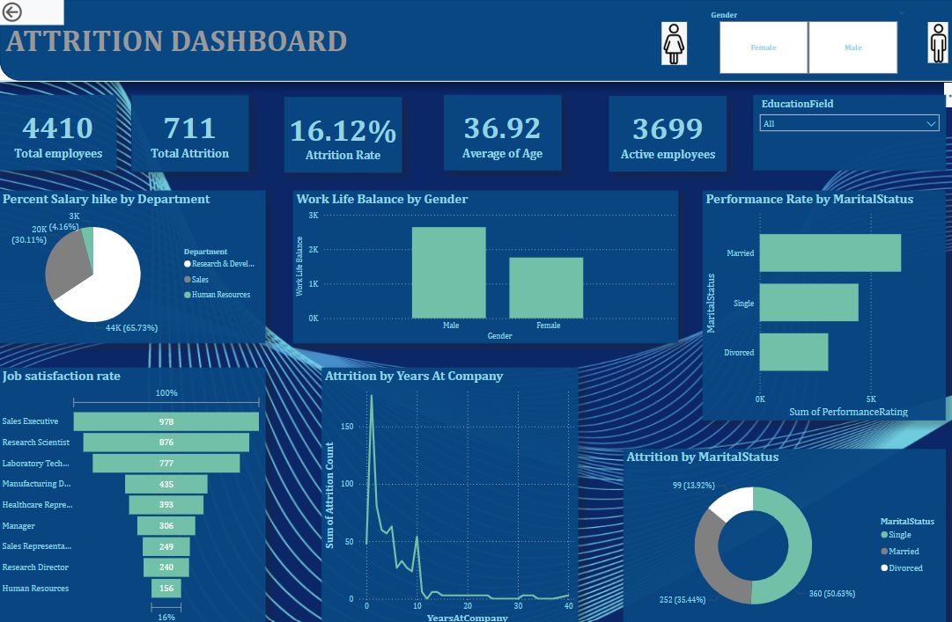
POWER BI DASHBOARD

Slide 4
WHY DO cause of attrition?
Unsatisfactory Compensation
Poor Work balance
Lack of growth opportunities
Lack of appreciation
Martial status

Slide 5

KEY METRICS
Overall attrition rate
The organization’s attrition rate stands at 16.12%, indicating the need for focused retention efforts.
Job satisfaction correlations
Department-wise attrition
There is a clear negative correlation between job satisfaction and attrition, underscoring the importance of employee engagement initiatives.
Certain departments exhibit higher attrition rates, suggesting the need for department-specific strategies.

Slide 6
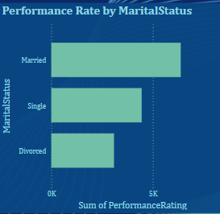
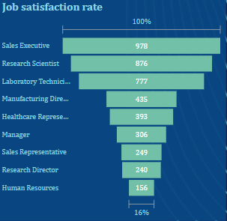
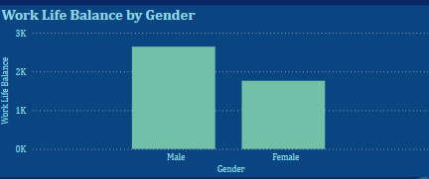
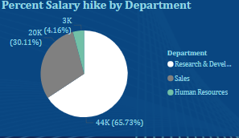
INSIGHTS:
The Total employee count is 4410 and total attrition count is 711
The attrition rate is 16.12%(Total attrition count / total employee count in %)
The average age of employee who left the company is 36.92
The employees currently working in this company is 3699
Employees that having 1 or less than 1 year experience are leaving the company more.
The work life balance is more for male
The performance rate is more for married peoples
The job satisfaction rate is more of sales executive
For the department Research and development having more percent salary hike
The male employees(16%) have more attrition rate than female employees(15%)
The active employees are more in life science field

Slide 7
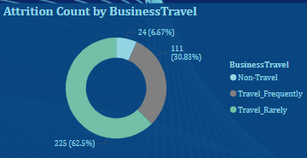
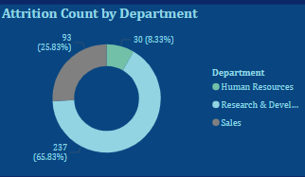
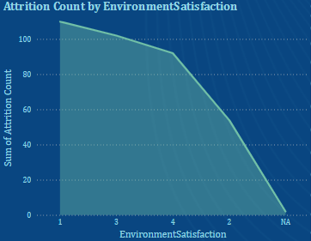
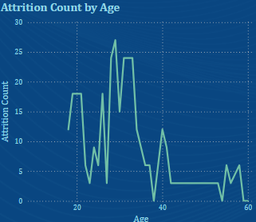
ATTRITION INSIGHTS:
Employees that having 1 or less than 1 year experience are leaving the company more.
Employees that having marital status single
Employees that not having satisfactory work life balance ,job and environmental status
Also employees that have to business travel frequently also tend to leave the company more.
Employees that are working on job role research director is leaving the company more.
In terms of attrition count is more for the age 29.
The attrition count is more in research and development department
Employees with 11% to 13% salary hike are more leaving the company.
Maximum number of employees are dissatisfied with companies environment

Slide 8
How to reduce attrition?
Offer Competitive Compensation and Benefits
Provide Opportunities for Career Development
Promote Work-Life Balance
Create a Positive Work Environment
Conduct Exit Interviews
Monitor and Analyze Attrition Trends
Provide Regular Feedback and Recognition

Slide 9
conclusion
Employees are mostly leaving the company for the imbalance on the work life balance, job satisfaction, travelling, over time and salary hike. To reduce the attrition rate need to do proper measures from the company side.

